Slide 1
HSA Kernel Mode Driver
Advisor: 徐慰中教授
Student: 黃昱儒
2015/4/20

Slide 2
Agenda
Introduction to HSA
  hUMA
  User Level Queueing
HSA Driver
  Flow Overview
  User & Hardware Queues
IOMMU
  GCR3
  PPR
HSA Virtualization
  Background
  Virtualization Idea & Architecture

Slide 3
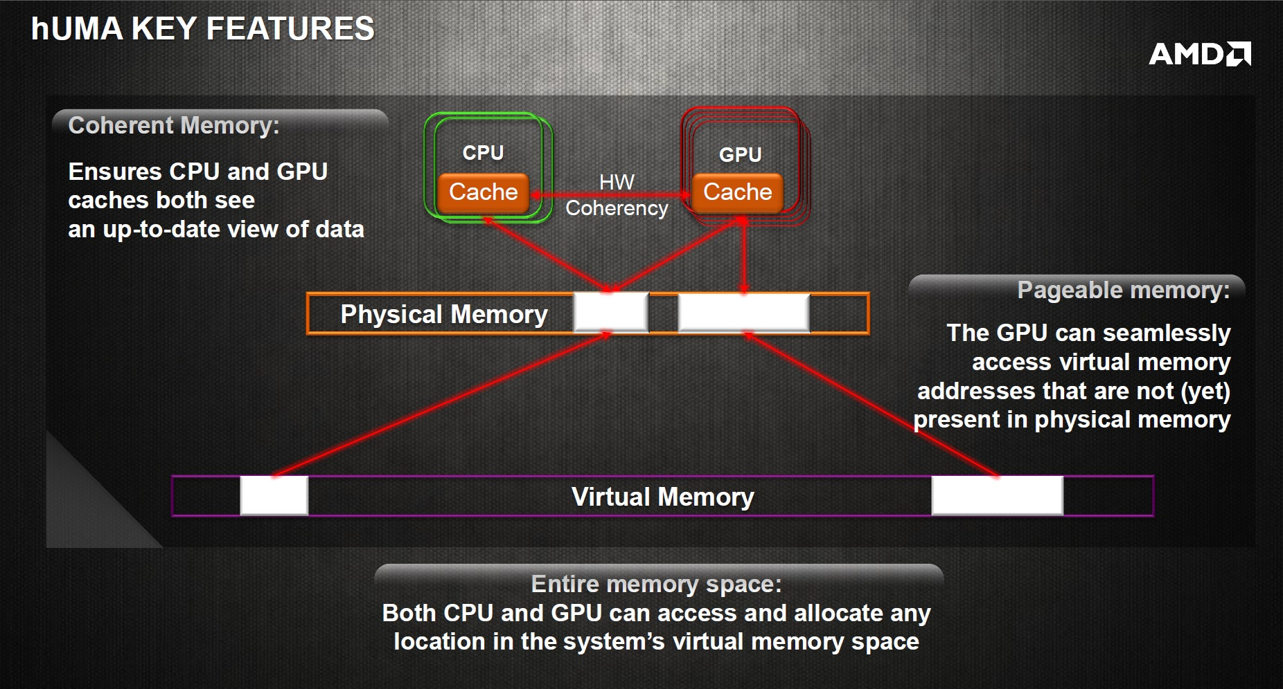
hUMA

Slide 4
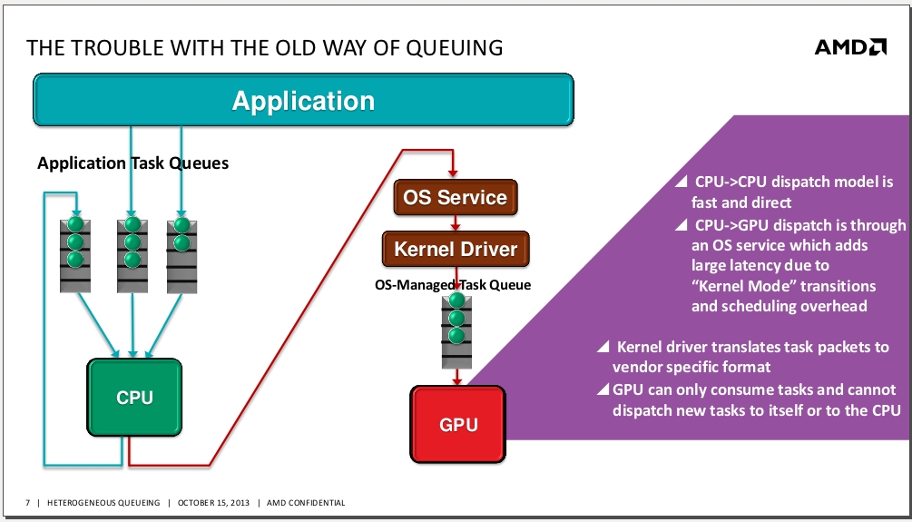
User Level Queuing - Before HSA

Slide 5
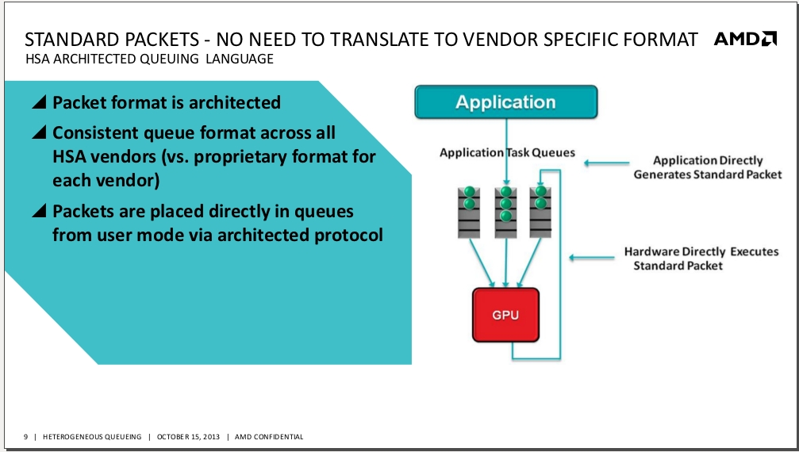
User Level Queuing

Slide 6
wptr
AQL Packet
Ring (Application queue)
Doorbell
Application 1
Queue 1
(In VA)
rptr
HSA device access application’s ring
wptr
Application 1
Queue 2
(In VA)
rptr
HSA Device
Application kick doorbell
wptr
Application 2
Queue 1
(In VA)
rptr
wptr
IOMMU address translation
(VA->PA)
Application 3
Queue 1
(In VA)
rptr

Slide 7
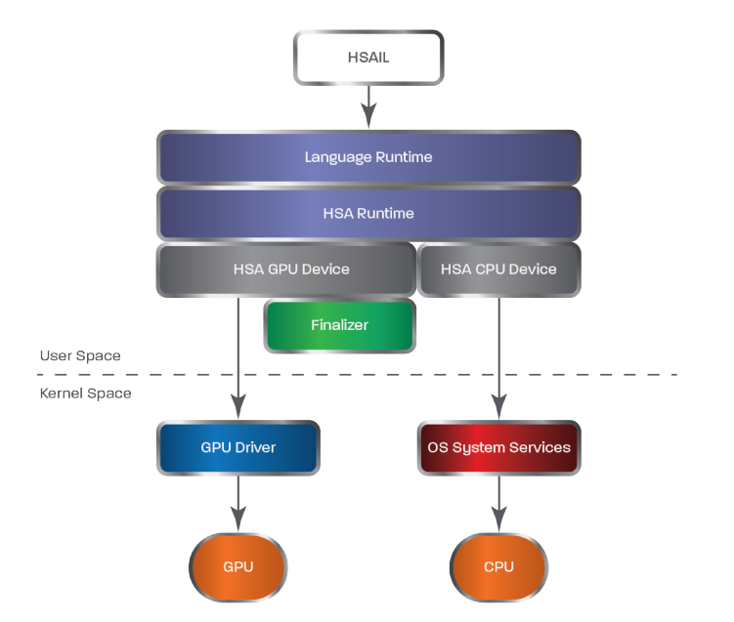
HSA Software Stack

Slide 8
HSA Software Stack
Application
Runtime Library
open(“/dev/kfd”)
ioctl(KFD_IOC_SET_MEMORY_POLICY)
ioctl(KFD_IOC_CREATE_QUEUE)
ioctl(KFD_IOC_DESTROY_QUEUE)
libhsakmt
HSA-aware Kernel
KFD
IOMMU Driver
HSA Device
IOMMU

Slide 9
Agenda
Introduction to HSA
HSA Driver
  Concepts
    Flow Overview
    User & Hardware Queues
  Source Code Detail
IOMMU
HSA Virtualization

Slide 10
Concepts - HSA Run Flow
User Space
Kernel Space
Create user queues
Create HW queue with user queue information
Initialization
User - HW interaction
Enqueu AQL packets, kick doorbell, and wait signal
Nothing
Computation
Application finish and destroy queues
Release HW queue
Finish
Notes:
User queue with information

Slide 11
Scheduled Policy
(Queue Binding Policy)
Hardware policy with oversubscription (more queues than HW slots)
HW policy without oversubscription
  create_queue requests fail when run out of HW slots
SW policy, driver manually assigns queues to HW slots by programming HW configuration registers

Slide 12
Software Policy
pasid=0
queue_id=0
pasid=0
queue_id=1
pasid=1
queue_id=0
pasid=1
queue_id=1
read_pointer_address
read_pointer_address
read_pointer_address
read_pointer_address
write_pointer_address
write_pointer_address
write_pointer_address
write_pointer_address
ring_base_address
ring_base_address
ring_base_address
ring_base_address
doorbell
doorbell
doorbell
doorbell
Free hardware queue_id bitmap
(pipe, queue)
queue acquire register
Physical Address
HSA GPU’s configuration register mmio address
Notes:
Driver’s help
ring VA
SW 7*8 = 56

Slide 13
Hardware Policy - No Oversubscription (1)
kernel_queue
ring_base_address
doorbell
(pipe=4, queue=0)
queue acquire register
Physical Address
HSA GPU’s configuration register mmio address
Notes:
Oversubscription
dqm->processes_count >= VMID_PER_DEVICE) || // 8
dqm->queue_count >= PIPE_PER_ME_CP_SCHEDULING * QUEUES_PER_PIPE))) // 24
SW 7*8 = 56

Slide 16
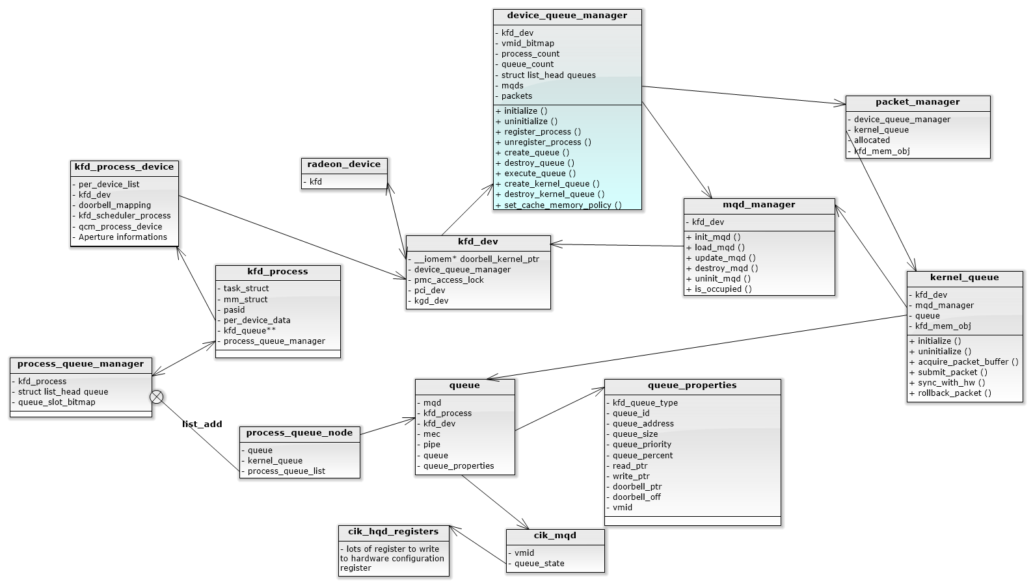
Per Device
Only for HW Policy
Per Application
Per Queue
Notes:
per_device_data
scheduler_class

Slide 17
IOCTL Command Provided by KFD
KFD_IOC_CREATE_QUEUE
  Create hardware queue from application’s information (ex: ring base address)
KFD_IOC_DESTROY_QUEUE
  Release hardware queue
KFD_IOC_UPDATE_QUEUE
KFD_IOC_SET_MEMORY_POLICY
  Set cache coherent policy
KFD_IOC_GET_CLOCK_COUNTERS
  Get GPU clock counter
KFD_IOC_PMC_ACQUIRE_ACCESS
KFD_IOC_PMC_RELEASE_ACCESS
  Exclusive access for performance counters
KFD_IOC_GET_PROCESS_APERTURES
  Get apertures information of GPU
KFD_IOC_CREATE_VIDMEM
KFD_IOC_DESTROY_VIDMEM
  Used for GPU local memory
Notes:
KFD is HSA driver!

Slide 18
HSA Driver Flow
System intialization
  module_init
  device_init (Called by radeon)
Application open “/dev/kfd” device
Application send ioctl
  KFD_IOC_SET_MEMORY_POLICY
  KFD_IOC_CREATE_QUEUE
Application send ioctl
  KFD_IOC_DESTROY_QUEUE
Application termination
Notes:
Start code

Slide 19
module_init(kfd_module_init)
radeon_kfd_pasid_init
  Initialize PASID bitmap
  PASID 0 is reserved
radeon_kfd_chardev_init
  register_chrdev: /dev/kfd
  kfd_ops
    Define open, ioctl, mmap member function

Slide 20
SW Policy

Slide 21
kgd2kfd_device_init
radeon_kfd_doorbell_init(kfd);
radeon_kfd_interrupt_init(kfd);
device_iommu_pasid_init(kfd);
kfd_topology_add_device(kfd);
amd_iommu_set_invalidate_ctx_cb(kfd->pdev, iommu_pasid_shutdown_callback);
device_queue_manager_init(kfd);
  dqm->initialize
dqm->start(kfd->dqm);
Notes:
kfd_topology_add_device: dev->gpu_id

Slide 22
dqm->initialize
Prepare pipe, queue bitmap

Slide 23
kfd_open
radeon_kfd_create_process(current)
  Create kfd_process
  Assign PASID

Slide 24
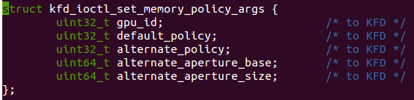

KFD_IOC_SET_MEMORY_POLICY
Two policy
  cache_policy_coherent
  cache_policy_noncoherent
Aperture used for GPU local memory
Notes:
Wait for spec

Slide 25
radeon_kfd_bind_process_to_device
Called when user application send ioctl command
amd_iommu_bind_pasid()
  Register iommu with this kfd_process
  Also set page table to IOMMU
Notes:
per_device_data

Slide 26
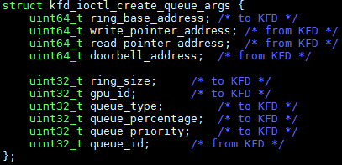
KFD_IOC_CREATE_QUEUE
Create queue with informations from userspace
Return queue_id and doorbell_address to user-space
  queue_id is per kfd_process
  doorbell_address map to device mmio address

Slide 27
pqm_create_queue
find_available_queue_slot
  Assign qid (per kfd_process)
dqm->register_process
  Register process to dqm (device queue manager)
create_cp_queue
  Create with queue_properties get from application
  Map doorbell mmio address to application
dqm->create_queue
dqm->execute_queue

Slide 29
dqm->execute_queue
Write queue configuration to device
load_mqd
  ring_base_addr
  doorbell_offset
  queue_priority
  ...

Slide 30
pasid=0
queue_id=0
pasid=0
queue_id=1
pasid=1
queue_id=0
pasid=1
queue_id=1
read_pointer_address
read_pointer_address
read_pointer_address
read_pointer_address
write_pointer_address
write_pointer_address
write_pointer_address
write_pointer_address
ring_base_address
ring_base_address
ring_base_address
ring_base_address
doorbell
doorbell
doorbell
doorbell
Free hardware queue_id bitmap
(pipe, queue)
queue acquire register
Physical Address
HSA GPU’s configuration register mmio address
Notes:
Driver’s help
ring VA
SW 7*8 = 56

Slide 31
HW Policy

Slide 32
kgd2kfd_device_init
radeon_kfd_doorbell_init(kfd);
radeon_kfd_interrupt_init(kfd);
device_iommu_pasid_init(kfd);
kfd_topology_add_device(kfd);
amd_iommu_set_invalidate_ctx_cb(kfd->pdev, iommu_pasid_shutdown_callback);
device_queue_manager_init(kfd);
  dqm->initialize
dqm->start(kfd->dqm);
Notes:
kfd_topology_add_device: dev->gpu_id

Slide 33
dqm->start
pm_init (packet manager)
kernel_queue_init
  kernel_queue doorbell
  kernel_queue ring address
  load_mqd to write kernel_queue configuration to device
Notes:
packet_manager’s most important member: kernel_queue

Slide 34
pqm_create_queue
find_available_queue_slot
  Assign qid (per kfd_process)
dqm->register_process
  Register process to dqm (device queue manager)
create_cp_queue
  Create with queue_properties get from application
  Map doorbell mmio address to application
dqm->create_queue
dqm->execute_queue

Slide 36
dqm->execute_queue
pm_send_runlist
  pm_create_runlist_ib
    Construct pm4 packet of MAP_PROCESS and MAP_QUEUES type
      Packet contains application’s ring address
  pm->kernel_queue->acquire_packet_buffer
    Get a not used entry of kernel_queue
  pm_create_runlist
    Construct pm4 packet of RUN_LIST type
  pm->kernel_queue->submit_packet
    Kick kernel queue’s doorbell

Slide 37
Hardware Scheduler - No Oversubscription
PM4 Packet (Type3)
IT_MAP_QUEUES
mqd_addr
(Memory Queue Descriptoy)
PM4 Packet (Type3)
IT_RUN_LIST
run_list
3 Processes
PM4 Packet (Type3)
IT_MAP_PROCESS
page_table_base
pasid
sh_mem_config
Notes:
http://amd-dev.wpengine.netdna-cdn.com/wordpress/media/2013/10/R6xx_R7xx_3D.pdf
HSA compilant HW need to understand pm4 packet format of radeon http://www.spinics.net/linux/lists/kernel/msg1784187.html
Type-0 Packet
Write N DWORDs in the information body to the N consecutive registers, or to the register, pointed to by the BASE_INDEX field of the packet header .
Type3:Carry out the operation indicated by field IT_OPCODE.

Slide 38
Hardware Scheduler - Oversubscription
PM4 Packet (Type3)
IT_MAP_QUEUES
mqd_addr
(Memory Queue Descriptoy)
PM4 Packet (Type3)
IT_RUN_LIST
run_list
PM4 Packet (Type3)
IT_MAP_PROCESS
page_table_base
pasid
sh_mem_config
PM4 Packet (Type3)
IT_RUN_LIST
run_list
Notes:
http://amd-dev.wpengine.netdna-cdn.com/wordpress/media/2013/10/R6xx_R7xx_3D.pdf
HSA compilant HW need to understand pm4 packet format of radeon http://www.spinics.net/linux/lists/kernel/msg1784187.html
Type-0 Packet
Write N DWORDs in the information body to the N consecutive registers, or to the register, pointed to by the BASE_INDEX field of the packet header .
Type3:Carry out the operation indicated by field IT_OPCODE.

Slide 39
SW Policy
HW Policy
Prepare (pipe, queue) bitmap
dqm->
initialize
dqm->
initialize
dqm->
start
pm_init
kernel_queue_init
dqm->
start
Create kfd_process
Assign PASID
kfd_open
Create kfd_process
Assign PASID
kfd_open
Get queue_id
Map doorbell to application
ioctl(CREATE_QUEUE)
Get queue_id
Map doorbell to application
ioctl(CREATE_QUEUE)
init_mqd
Find unused (pipe, queue) to assign HW queue_id
dqm->create_queue
init_mqd
dqm->create_queue
Write queue configuration to device
dqm->execute_queue
Create pm4 packet
Kick kernel_queue’s doorbell
dqm->execute_queue

Slide 40
Application Computation ...
HW has ring_base_addr user-space address
  Application enqueue AQL packet and wait signal
Application has HW doorbell mmio address
  Use to kick hardware
Driver do nothing
Until application send ioctl(KFD_IOC_DESTROY_QUEUE) or application finish

Slide 41
Haredware Queue Deactivation
Application send ioctl(KFD_IOC_DESTROY_QUEUE)
Task exit notifier

Slide 42
dqm->destroy_queue For SW Policy
destroy_mqd
  acquire_queue(kgd, pipe_id, queue_id);
  write_register(kgd, CP_HQD_DEQUEUE_REQUEST, DEQUEUE_REQUEST_DRAIN);

Slide 43
dqm->destroy_queue For HW Policy
dqm->destroy_queues
  pm_send_unmap_queue
    Send a pm4 packet of UNMAP_QUEUES
  pm_send_query_status(KFD_FENCE_COMPLETED)

Slide 44
Haredware Queue Deactivation (2)
Task exit notifier will call iommu_pasid_shutdown_callback
  Register in kgd2kfd_device_init->amd_iommu_set_invalidate_ctx_cb
  Will be called in mmu_notifier’s release function (mmu_notifier is registered in radeon_kfd_bind_process_to_device->amd_iommu_bind_pasid)

Slide 45
Agenda
Introduction to HSA
HSA Driver
IOMMU
  Concepts
    GCR3
    PPR
  Source Code Detail
HSA Virtualization

Slide 46
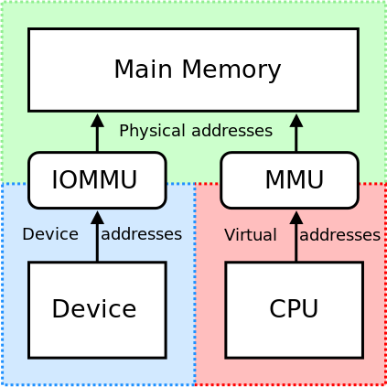
Introduction to IOMMU
User application send AQL packet into ring address which is virtual address
Device accessing need translate VA to PA

Slide 47
Assign this entry with kfd_process->mm->pgd
PASID=2
GCR3
HSA GPU
Device table

Slide 48
PRI & PPR
The operating system is usually required to pin memory pages used for I/O.
IOMMU provide mechnism to let peripheral to use unpinned pages for I/O.
Only support in AMD IOMMU_v2
Notes:
以前沒差,IOMMU只摸device address
For now, data in AQL packet is VA

Slide 49
PRI & PPR
PRI(page request interface)
  peripheral request memory management service from a host OS (eg, page fault service for peripheral)
  Issued by peripheral
﻿PPR(peripheral page service request)
  When IOMMU receives a valid PRI request, it creates a PPR message in request log to request changes to virtual address space
  Issued by IOMMU as interrupt
Use to request IO page table change
  IOMMU driver can register PPR notifier

Slide 50
module_init(amd_iommu_v2_init)
amd_iommu_register_ppr_notifier(&ppr_nb);
  PPR callback
    ppr_notifier function

Slide 51
amd_iommu_bind_pasid
Called when kfd_process create
  mmu_notifier_register(&pasid_state->mn, pasid_state->mm);
  amd_iommu_domain_set_gcr3(dev_state->domain, pasid, __pa(pasid_state->mm->pgd));
Notes:
IO page fault service and need to notify CPU page service

Slide 52
Assign this entry with kfd_process->mm->pgd
PASID=2
GCR3
HSA GPU
Device table

Slide 53
PRI & PPR Flow
Peripheral issue PRI to IOMMU
IOMMU write PPR request to PPR log
(log contains fault address, pasid, device_id, tag, flags)
IOMMU send interrupt to CPU

Slide 54
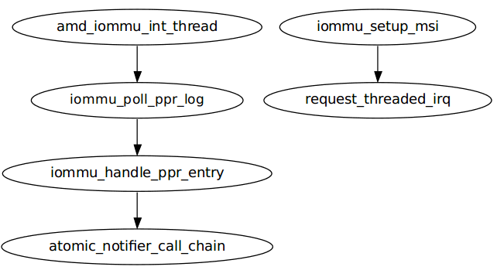
PPR Flow
When irq comes
readl(iommu->mmio_base + MMIO_STATUS_OFFSET);
if (status & MMIO_STATUS_PPR_INT_MASK)
ppr_notifier
Register in amd_iommv_v2_init
do_fault

Slide 55
do_fault
get_user_pages() API to pin fault pages into memory
  mm_struct, fault_addr

Slide 56
Flow Review
Application
Runtime Library
open(“/dev/kfd”)
ioctl(KFD_IOC_SET_MEMORY_POLICY)
ioctl(KFD_IOC_CREATE_QUEUE)
ioctl(KFD_IOC_DESTROY_QUEUE)
libhsakmt
HSA-aware Kernel
KFD
IOMMU Driver
HSA Device
IOMMU

Slide 57
Agenda
Introduction to HSA
HSA Driver
IOMMU
HSA Virtualization
  Background
  Virtualization Idea & Architecture

Slide 58
System Virtualization
How to do?
  For same ISA virtualization, just load guset OS kernel into memory and set PC
We need guest OSes are isolated !!!
How to manage system resource?
  CPU virtualization
  Memory virtualization
  I/O virtualization

Slide 59
CPU Virtualization
Without Virtualization Extension
With Virtualization Extension
User Mode
User Mode
Guest Application
Guest Application
Guest OS
Kernel Mode
Kernel Mode
Guest OS
Hypervisor
Hypervisor Mode
Hypervisor
Problem 1: system resouce control
Need binary translation or para-virtualization
Non-privileged Instruction
Privileged Instruction
Problem 1’s solution:
Trap critical instruction (control by hypervisor)
Problem 2’s solution:
System call trap into guest OS inside kernel mode
Critical Instruction
Sensitive Instruction
Privileged instruction: cause trap if executed in unprivileged mode
Sensitive instruction: interact with system resource
Critical instruction: sensitive but non-privileged instruction
Problem 2: unnecessary trap, ex:system call
Cause performance drop

Slide 60
Memory Virtualization
Without Virtualization Extension
With Virtualization Extension
Guest Virtual Address
(GVA)
Guest
APP
Guest Virtual Address
(GVA)
Guest
APP
Page Table
(Maintained by GOS)
Guest
OS
Guest
OS
Shadow Page Table
(Maintained by Hypervisor)
Guest Physical Address
(GPA)
Guest Physical Address
(GPA)
Page Table
(Maintained by Hypervisor)
Host Physical Address
(HPA)
Hypervisor
Host Physical Address
(HPA)
Hypervisor
System Memory

Slide 61
I/O Virtualization
Four technique
  Full virtualization
  Virtio
  Directed I/O (also called device pass-through)
  SRIOV (Single-Root I/O Virtualization)
    Above two is useful only when I/O virtualization extension support

Slide 62
Full Virtualization
第1000(0x3E8)號邏輯磁區開始
Guest OS
out 0x1F3, 0x00
out 0x1F4, 0x00
out 0x1F5, 0x03
out 0x1F6, 0xE8
out 0x1F2, 0x08
out 0x1F7, 0x20
Guest Driver
8個磁區
Trap
Hypervisor
讀取command (0x2)
Device Emulation
Physical Device Driver
Physical Device

Slide 63
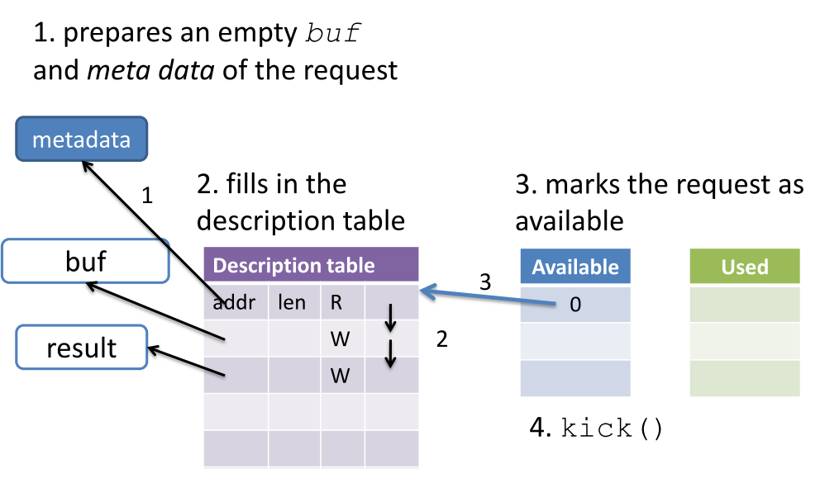
Virtio
Access Virtio MMIO region, cause trap

Slide 64
Virtio in KVM+Qemu
Guest OS
QEMU
Front-end driver
Share virtqueue
Back-end driver
Host kernel
KVM
Real device driver
Disk

Slide 65
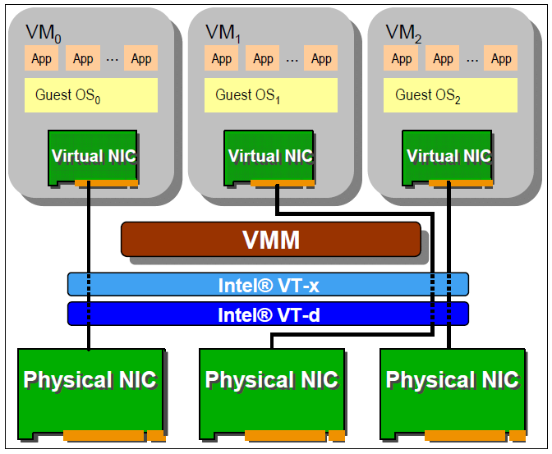
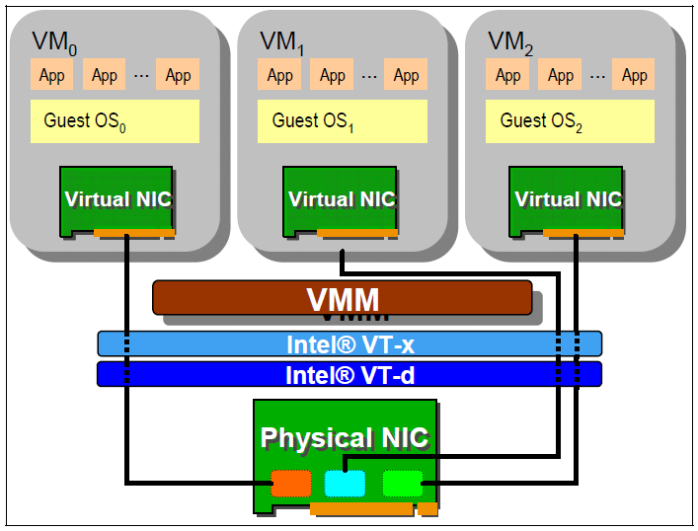
Device Pass-through
Device Pass-Through
Single Root I/O Virtualization (SR-IOV)

Slide 66
I/O Virtualization Extension - IOMMU
CPU
Guest
APP
I/O Device
Guest Virtual Address
(GVA)
Guest
OS
GPA
Page Table
(maintained by GOS)
IOMMU
Guest Physical Address
(GPA)
MMU
Device Driver
Guest Physical Address
(GPA)
Page Table
(maintained by Hypervisor)
Hypervisor
Page Table
(maintained by Hypervisor)
Host Physical Address
(HPA)
Host Physical Address
(HPA)
System Memory

Slide 67
More About I/O Virtualization
Principle: How to virtualize the HW interface
  Full virtualization & virtio: let qemu emulate
  Device pass-through: assign HW interface to guest
A Full GPU Virtualization Solution with Mediated Pass-Through
  Intel Corporation @ USENIX ATC’14
  HW interfaces
    Frame buffer: Partitioning
    Command buffer: Partitioning
    I/O registers: Emulate
    GPU page tables: Emulate

Slide 68
wptr
rptr
IOMMU address translation
(VA->PA)
Application 1
Queue 1
HSA device access application’s queue
wptr
Application 1
Queue 2
rptr
HSA Device
Application kick doorbell
wptr
Guest 1
Application 1
Queue 1
rptr
wptr
Need IOMMU second level address translation support
(GVA->IPA->PA)
Guest 2
Application 1
Queue 1
rptr

Slide 69
Guest Application
Qemu
(Host process)
HSA Runtime Library
open(“/dev/kfd”)
ioctl(KFD_IOC_SET_MEMORY_POLICY)
ioctl(KFD_IOC_CREATE_QUEUE)
ioctl(KFD_IOC_DESTROY_QUEUE)
Guest application queue address
Guest process page table
Virtio-KFD
Guest OS
Shared Virtqueue
Back-end Driver
Enable IOMMU two-stage translation
Host OS
KVM
KFD
IOMMU Driver
HSA Device
IOMMU

Slide 70
Handle I/O Page Fault
Process1
Process2
Process3
Host OS
Get fault address, process context
IOMMU Driver
Interrupt
IOMMU

Slide 71
Handle Guest I/O Page Fault
Guest
Process1
Guest
Process
2
Guest
Process
3
Map guest fault log region
Guest OS
Qemu
virtio-iommu
Back-end
Get fault address, process context
allocate guest fault log region
mmap
KVM
Host OS
IOMMU Driver
Shadow PPR log
KFD Driver
Interrupt
IOMMU

Slide 73
Reference
https://github.com/HSAFoundation/HSA-Drivers-Linux-AMD
http://www.hsafoundation.com/standards/
http://www.intel.com/content/www/us/en/pci-express/pci-sig-sr-iov-primer-sr-iov-technology-paper.html
https://www.usenix.org/system/files/conference/atc14/atc14-paper-tian.pdf

Slide 74
Q&A
Thanks!

